Slide 1

Introduction
Using R is a long road
I am hoping this can provide a easy introduction into using it as a data pipeline
You can join AIR-RUG (Association for Institutional Research R-User Group) for support in all your work

Slide 2
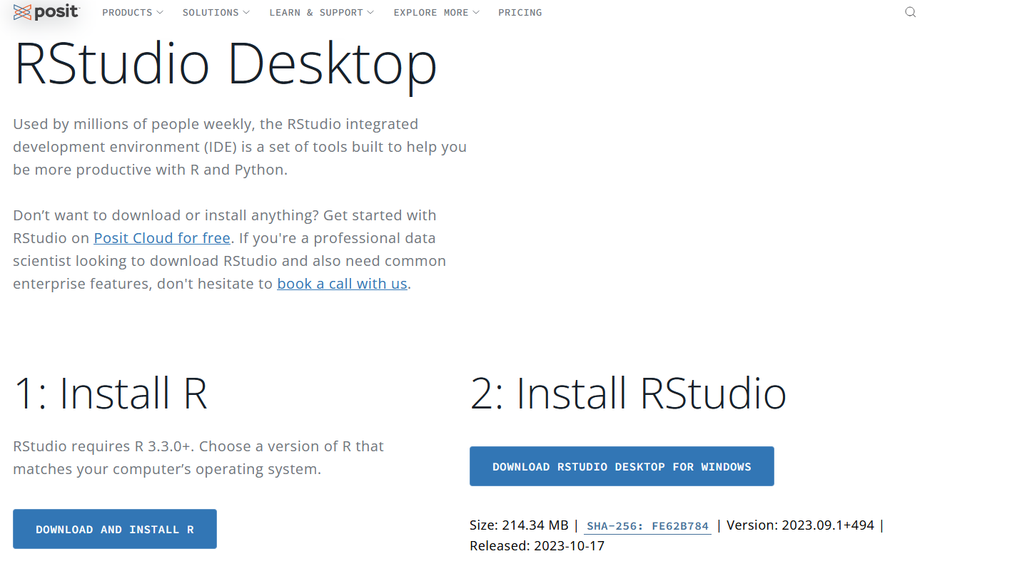
Installation
There are two ways you can use R and R Studio
Install R https://cran.r-project.org/
Install R Studio from POSIT https://posit.co/download/rstudio-desktop/
Note the last link will have links to both R and R Studio

Slide 3
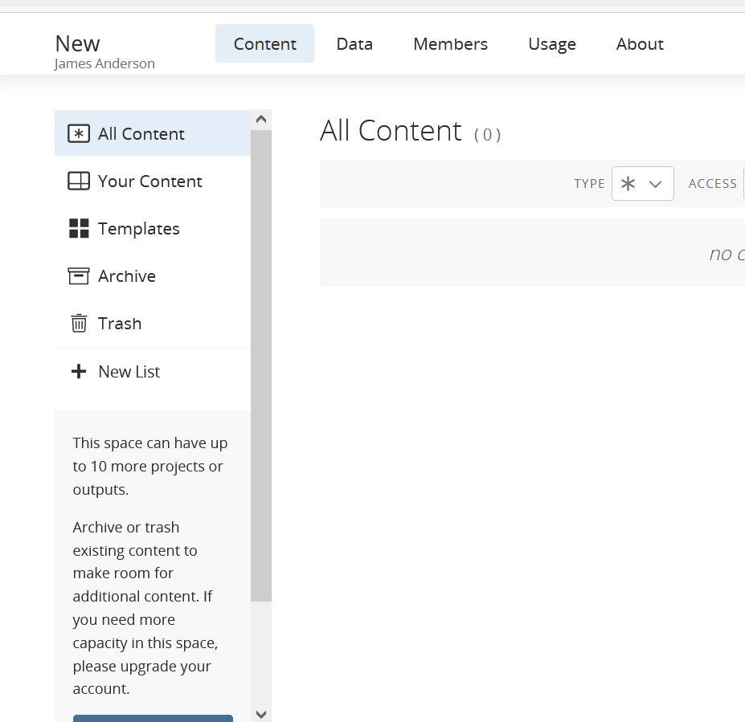
Online
The second way is to work with it online
Posit has an online option that is free
Access at https://posit.cloud/
You have a 25 projects and 25 hours free
If you don't have Rstudio installed already please use that for today!

Slide 4
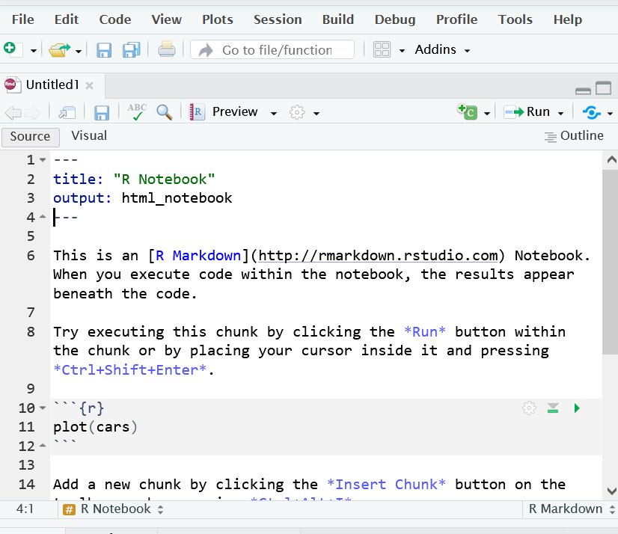
RMD file structure
A RMD file is a way to create a document that will turn into PDF, Word, or HTML document with code in it.
It allows you to use R, python, html, or other code in a document
You can use LaTex writeup and YAML headers to create the document
Lets go and look at one now!

Slide 5
Packages
Some Important Packages
Tidyverse: an ecosystem of packages by Hadley Wickman
kableExtra: a handy table creation package that I use daily by Hao Zhu
readxl: Importing excel files from Jenny Bryan
scales: Used mostly for percentages, also by Hadley Wickman
One of the most versatile part of R is the use of packages.
What are packages?
I have some code that I made that other people have found useful
I write it up and create a "package" of functions to use
Other people can download and use the package

Slide 6
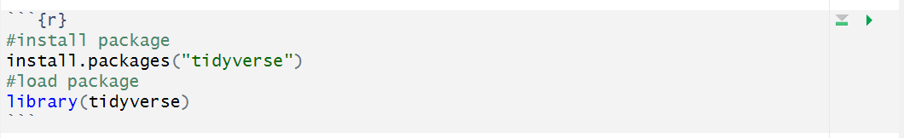
Installation and loading of Packages
You use the command install.packages to install an individual package.
A package only has to be installed once. Once it is installed, you still have to load it into the environment in order to use it.

Slide 7
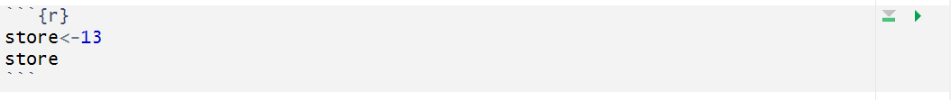
Storing Objects
We can make a code section by clicking on insert new code section or ctrl+alt+i
The <- symbol is used to store objects for later use without having to retype them
The name of the object cannot start with a number

Slide 8
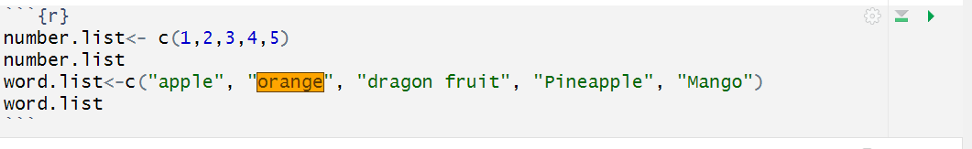
Lists
R uses the letter c to start lists (The c means combine)
You can use numbers or words in the list
Words use quotations around each individual entry

Slide 9
Dataframes
A data frame is a combination of rows and columns
You can combine lists into a data frame
You can import data as a data frame
You can merge data using left join, right join, and inner joins (not covered today)

Slide 10
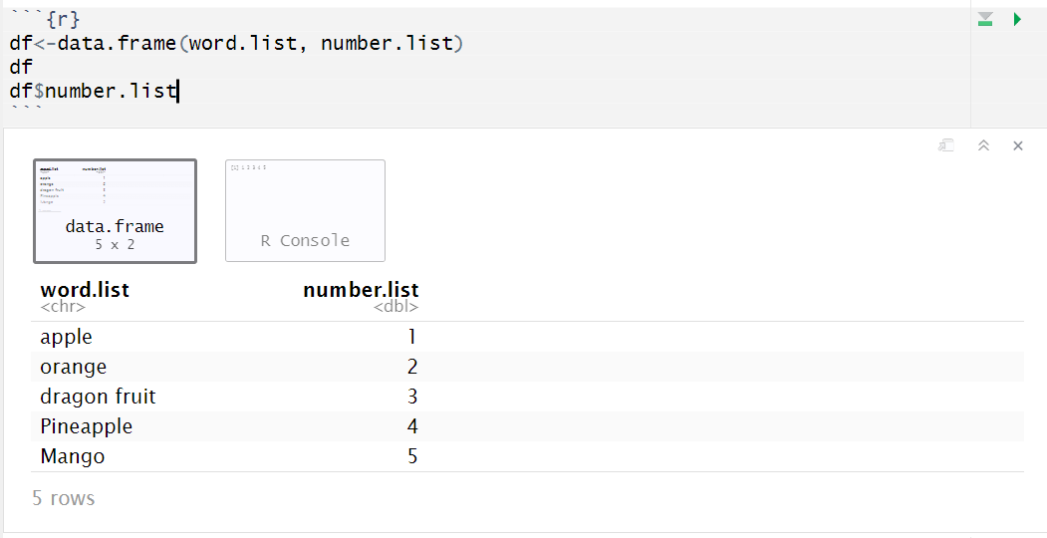
Combining lists using data.frame
data.frame allows you to take lists of similar data and put them in as individual columns of data in a data frame.
From here, I can call individual columns like so:

Slide 11
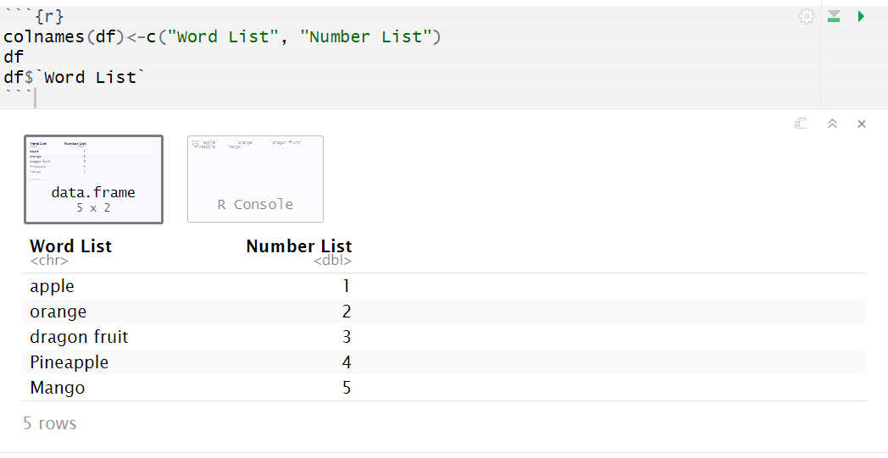
Adding column and row names
Also, since this will most likely be turned into a table, we don't like those columns.- We can rename the columns using the following command.- When we do so, the way that the column pulls up changes (notice it's in single quotes now)

Slide 12

Importing Data
We can use a couple different ways to import data
R can load nearly all types of data including
CSV
Excel
SAS save files
Table Files
Text Files
Many more (I've even loaded GPS data files once)

Slide 13
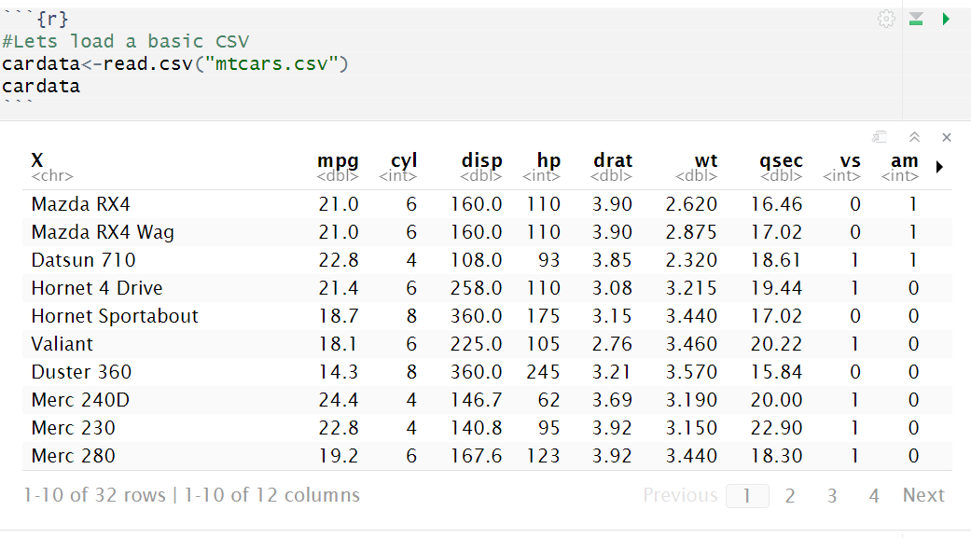
Loading a CSV file
The read.csv file loads csv files

Slide 14
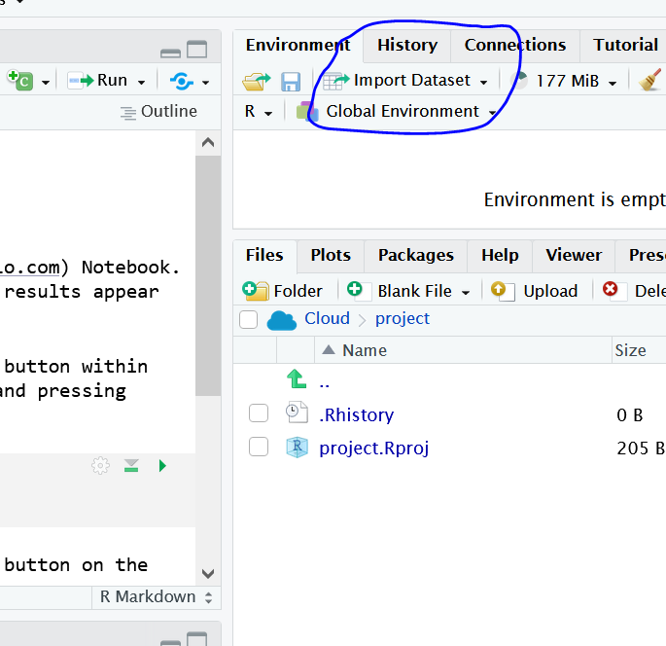
Using a GUI to make life easier!
We don't always have things where they are easy, so we can make things easy for you to load!
The top right of your Rstudio GUI has an area for Importing Data that we can use to make life easier!
Make sure Environment Tab is selected
Click on Import Dataset
Select Type of Data you want to import (avoid base to make it more user friendly)
If you are using POSIT online you need to upload your file now
Click Browse to search for file
Change the name in the bottom left to a descriptive name
Copy the first two lines of code in the bottom right
Paste the code into a code section

Slide 15
Naming Code Sections
When you are working, things break randomly and you have to fix them
We like to know where they break, especially if you are using code sections
Use descriptive names by clicking on the wheel in the code section or by typing next to the r in the code section

Slide 16
Suppressing code, output, and messages
We don't always want to show code, you usually don't want messages, and sometimes don't even want to run the code.
We can suppress warnings like this

Slide 17
Suppressing code, output, and messages
We don't always want to show code, you usually don't want messages, and sometimes don't even want to run the code.
We can also suppress output like this

Slide 18
Suppressing code, output, and messages
We don't always want to show code, you usually don't want messages, and sometimes don't even want to run the code.
We can also suppress code like this

Slide 19
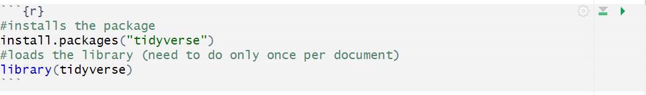
Welcome to the TidyVerse!
Installation of tidyverse

Slide 20
What is tidyverse?
Tidyverse is a collection of packages created by Hadly Wickman. It allows for:
Data wrangling from the dplyr package for filtering, transforming, and summarizing data
Data Visualization from ggplot2 package for flexible and working visualizations
All basic commands, such as pipes, interwork in the system allowing for ease of use

Slide 21

dplyr, the pipe, and summarise
A lot of what we do in Institutional Research is to take data and summarize it.
The dplyr package uses pipes and summarise to do a lot of what we do easily

Slide 22
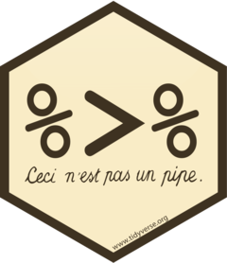
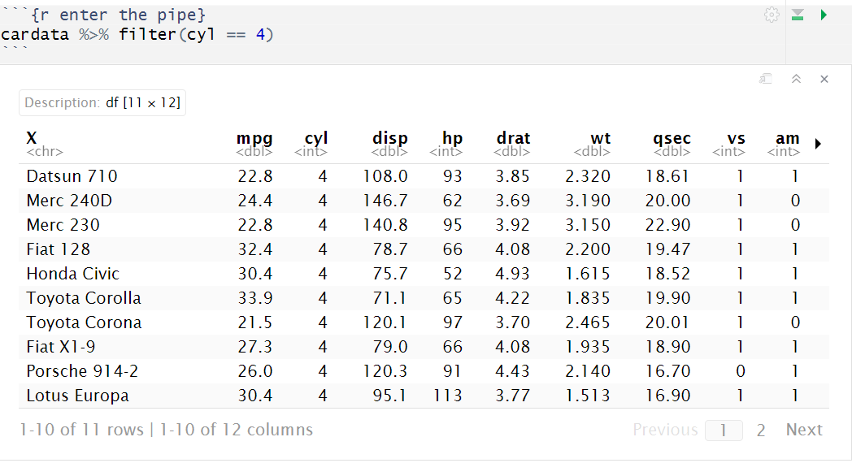
Lets use the pipe
I can use the pipe to take the output of one of the things I'm doing and use it in the next.
If I want to only filter out, for instance, cars with 4 cylinders I can use filter

Slide 23
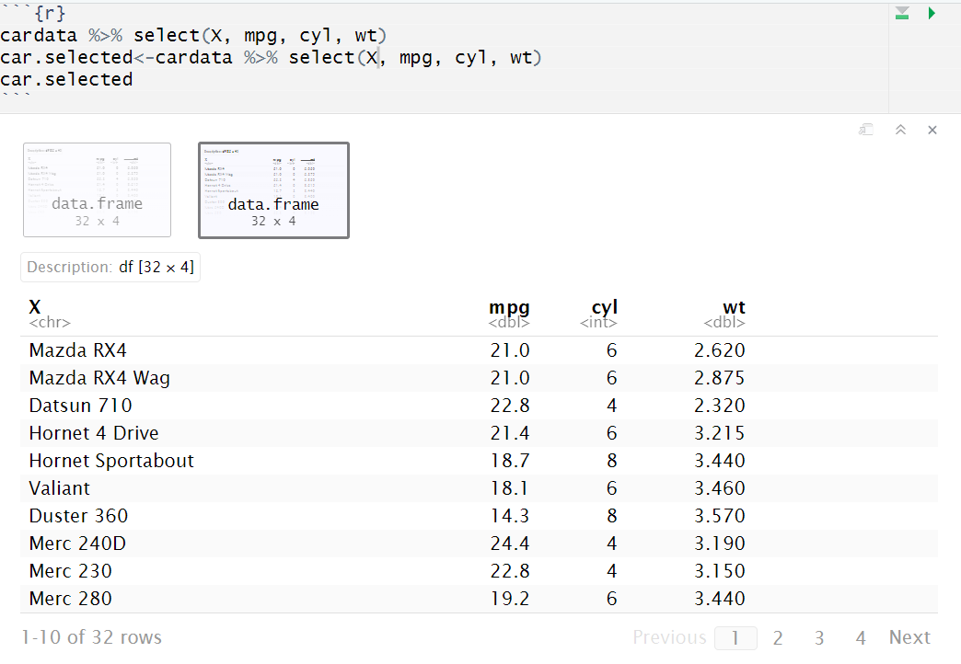
Selecting Columns
If I only want to select certain things, I can do that as well using select

Slide 24
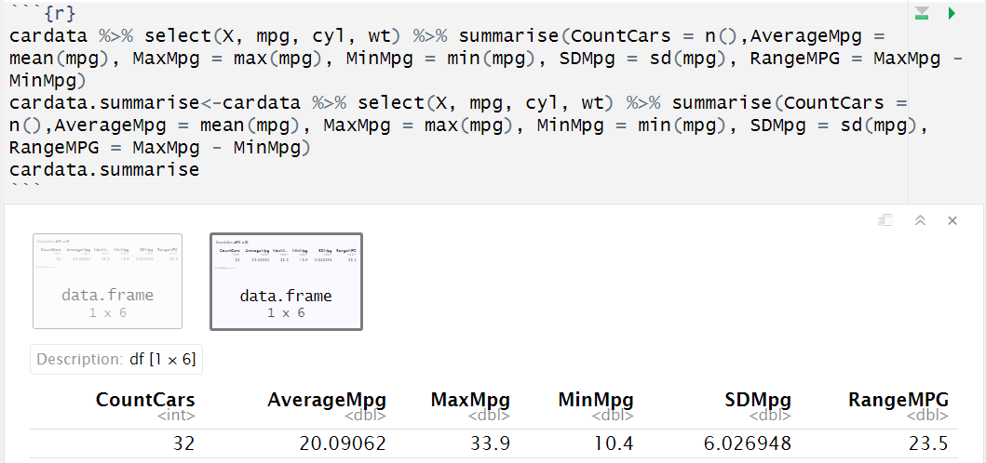
Summarizing
I can use summarise in order to do basic statistical commands.
It can create counts, means, max, min, standard deviation, and call upon different functions.

Slide 25
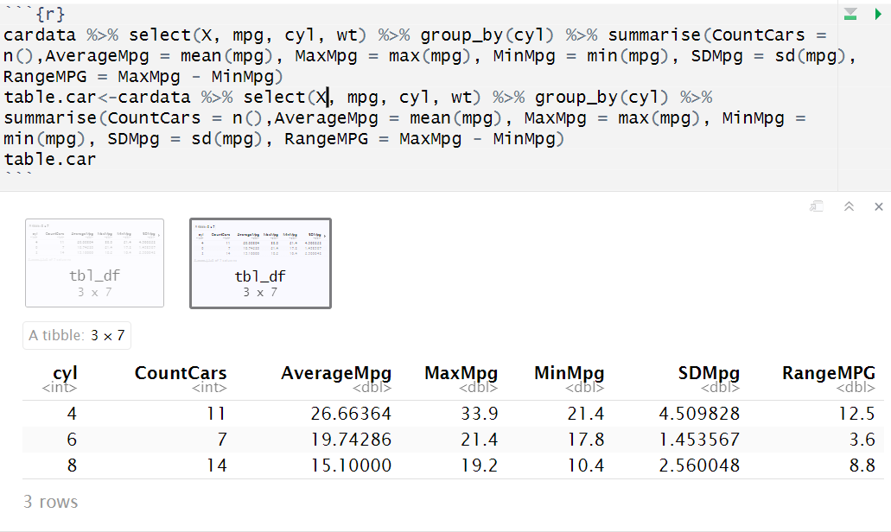
Grouping
The real power comes when you start using group_by in order to create wider tables.
Lets group the cars based on cyl

Slide 26
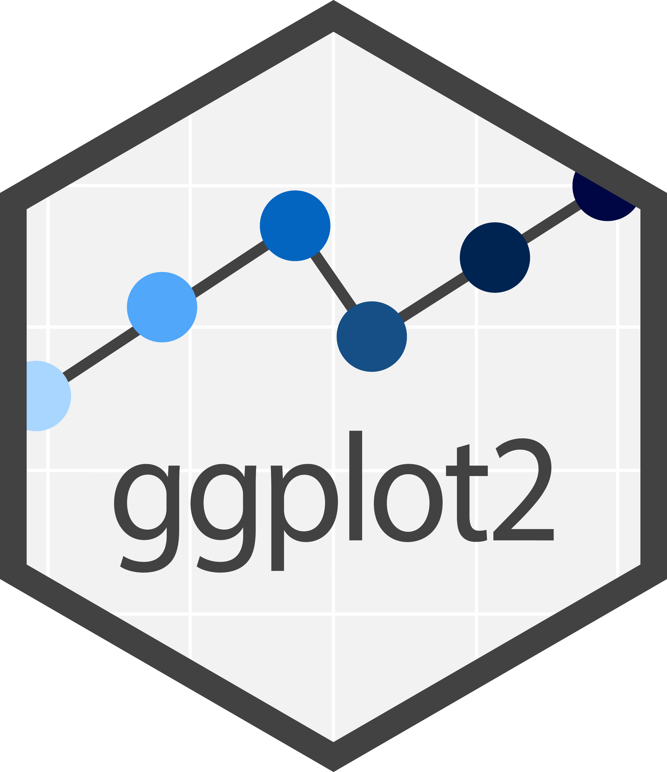
Graphing
The package ggplot2 is a massive tool that has a wide variety of information in it.
You can learn to plot many different things in the program
Simple x by y plotting
Adding extra dimensions through color and fill
Create a wide variety of types of plots like line, smooth, histograms, and more!

Slide 27
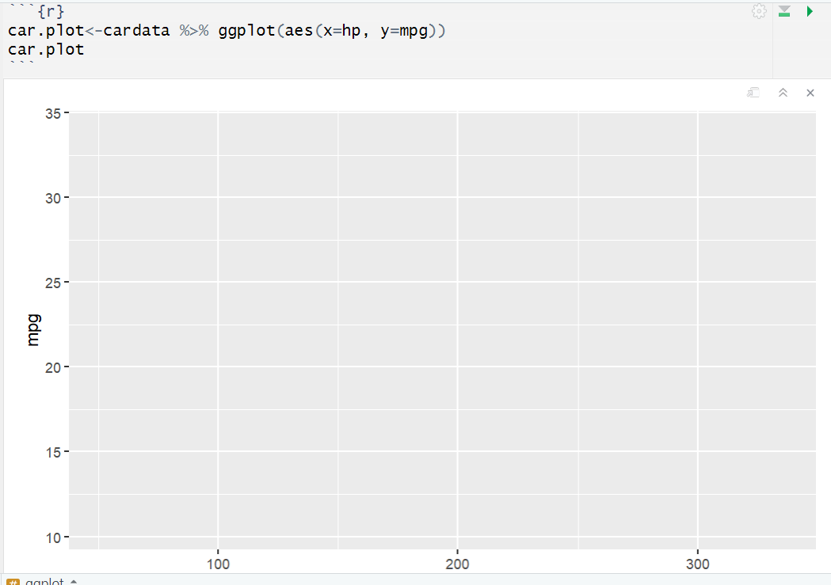
ggplot
Lets start with the pipe and into ggplot!
Nothing shows up because we didn't tell it to do anything!

Slide 28
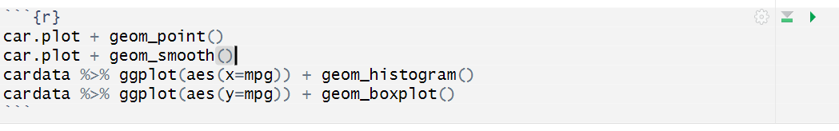
Types of Plots
We have a few different types of basic plots
geom_point (or geom_jitter) adds a scatterplot
geom_smooth adds a smooth line
geom_histogram adds a histogram
geom_boxplot adds a boxplot

Slide 29
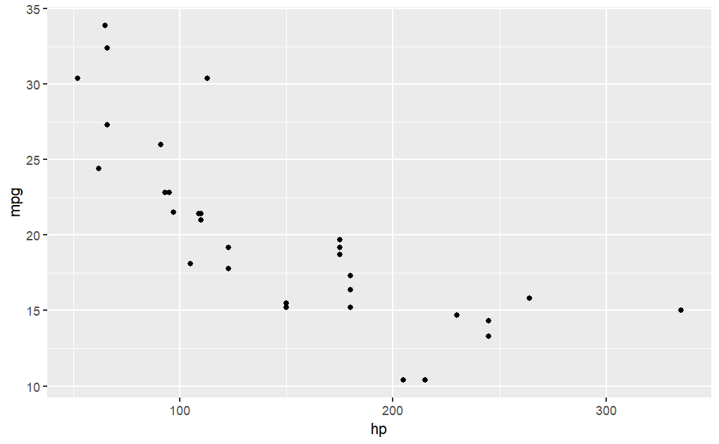
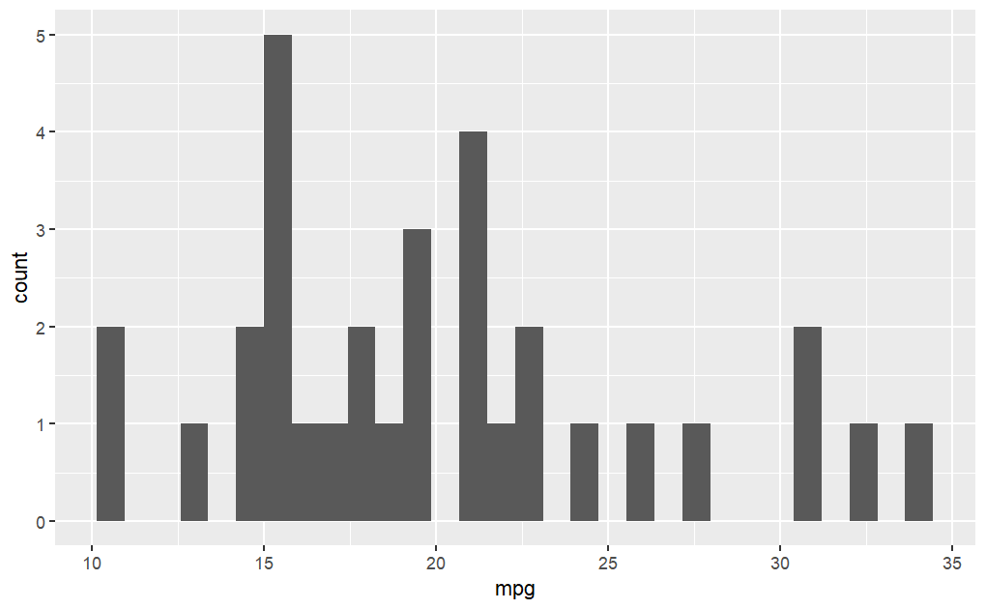
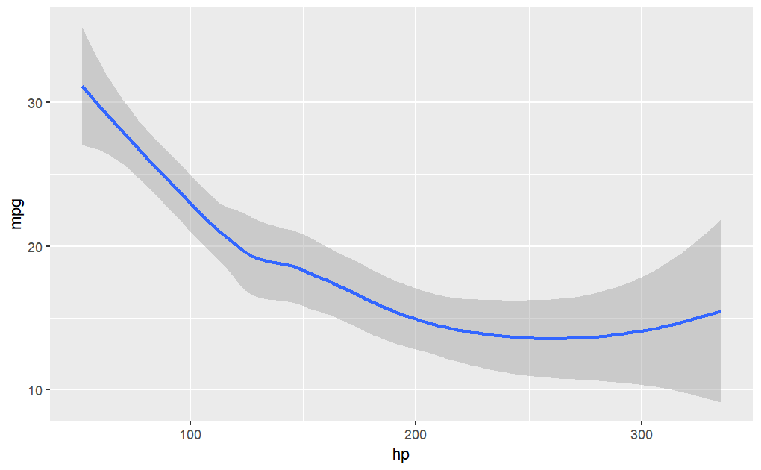
Types of Plots

Slide 30
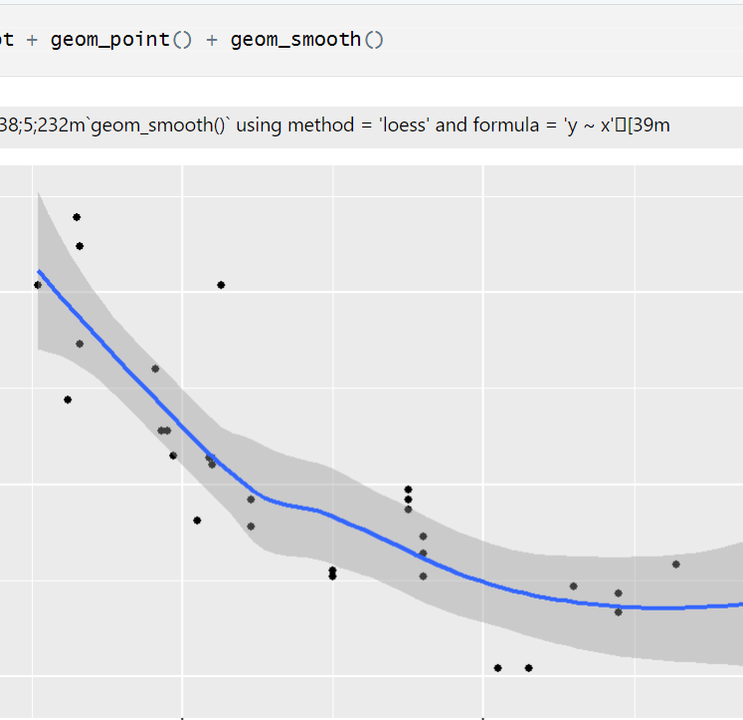
Multiple elements in the same graph
We can do multiple elements in the same graph as well.
Just use a + and add more

Slide 31
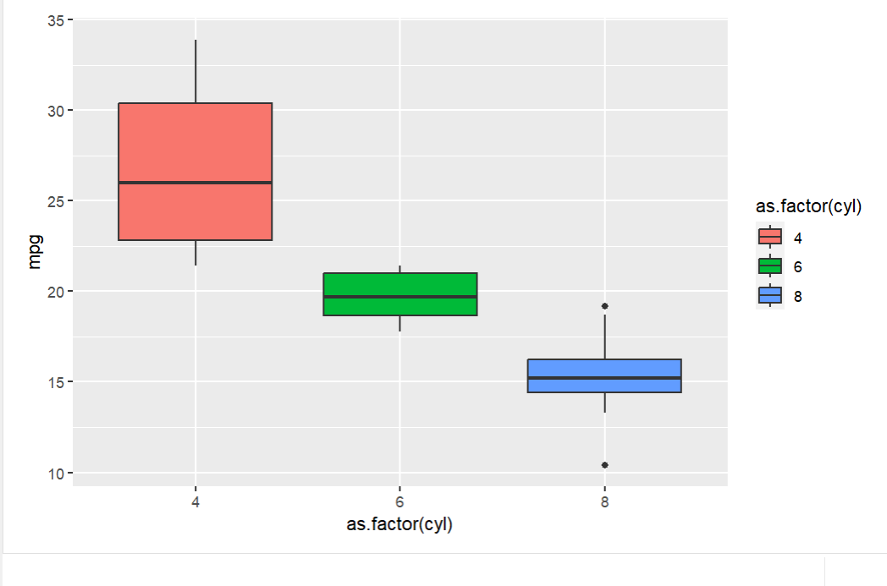
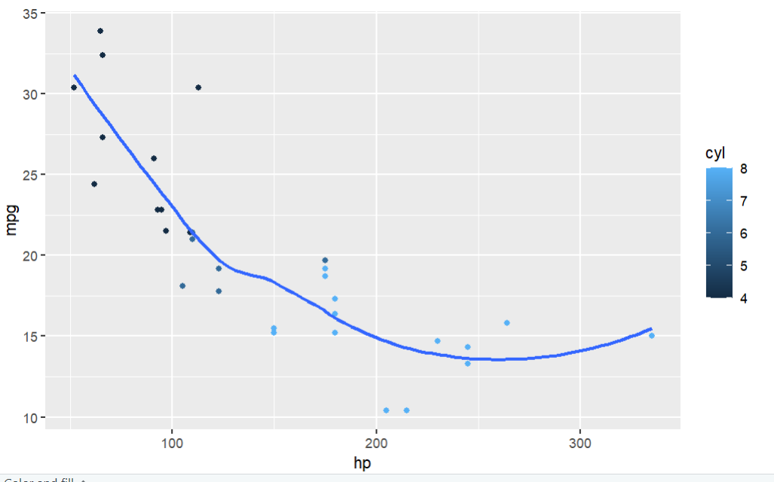
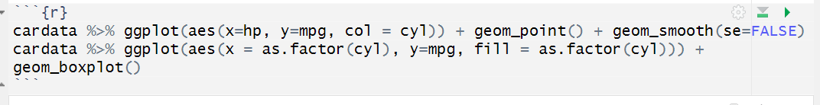
Color and fill
We can use col and fill in aes to add a third dimension

Slide 32
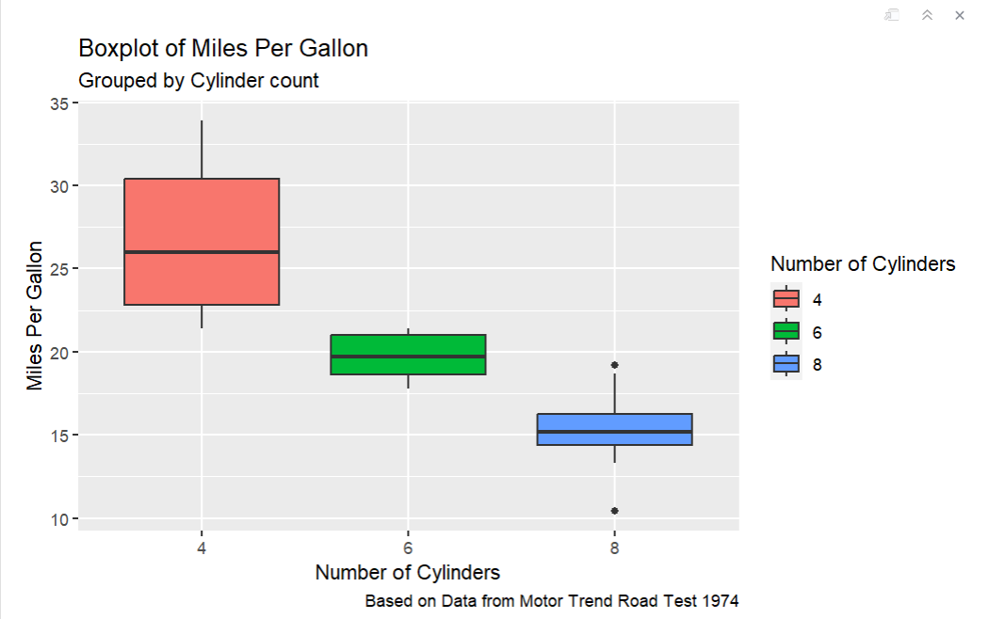
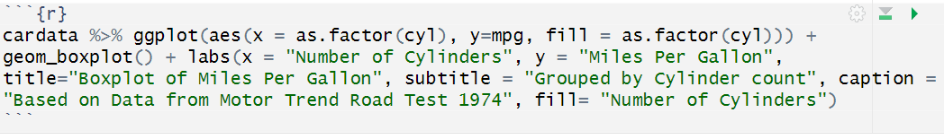
Making them look better
We can label the title, subtitle, x, y and legend using labs

Slide 33
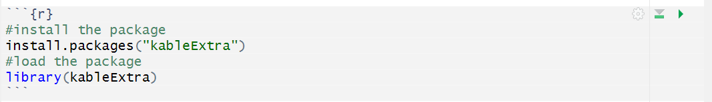
Making Tables with kableExtra
The Packages
The kableExtra package is one that lets you create publication ready tables for use in pdf and HTML documents.
We can use the tables we created in tidyverse in order to make tables.
The hard part of this is that you can only see them when they are rendered (we will revisit this in a little bit)

Slide 34
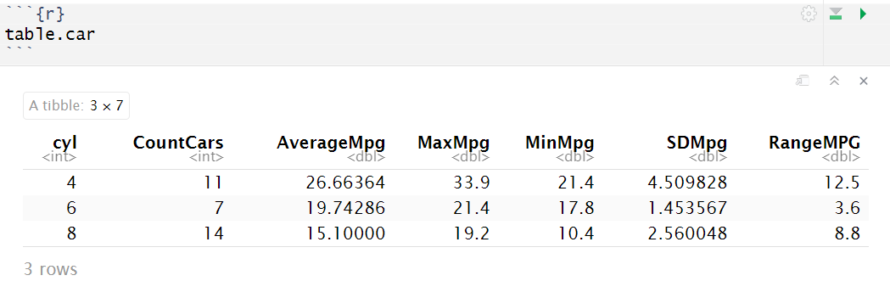
The table we will use
We made the table of MPG based on cylinders before. Lets use that now.

Slide 35
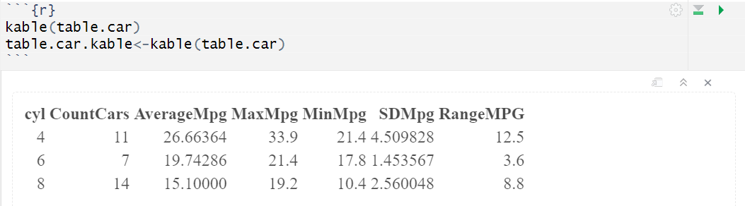
kable function
A basic table is made using kable. We can see the basic output.

Slide 36
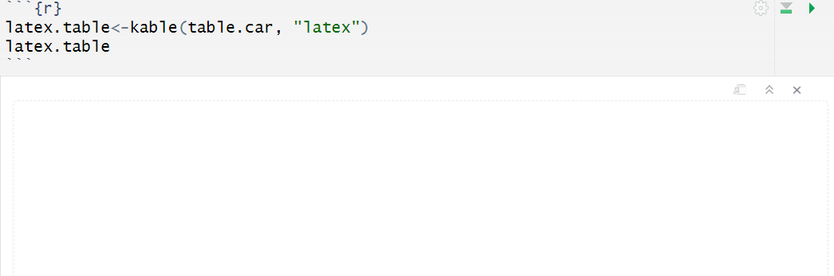
kable function
If we want to make it into a pdf, we use latex, if we are making an html, we use html.
Note, once you use LaTex you will not be able to see it in the output only at the end!!

Slide 37
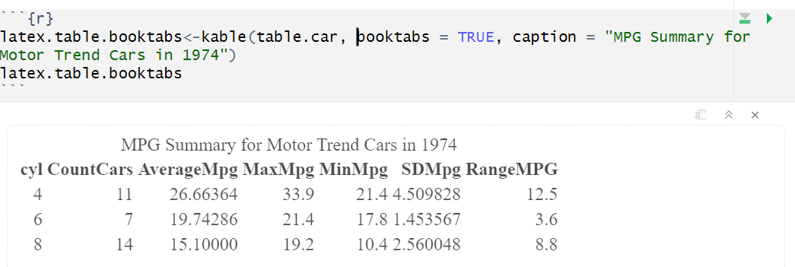
Making it look nice
I use the booktabs = TRUE for a specific style of table
Caption can be used in order to create a title to the table

Slide 38
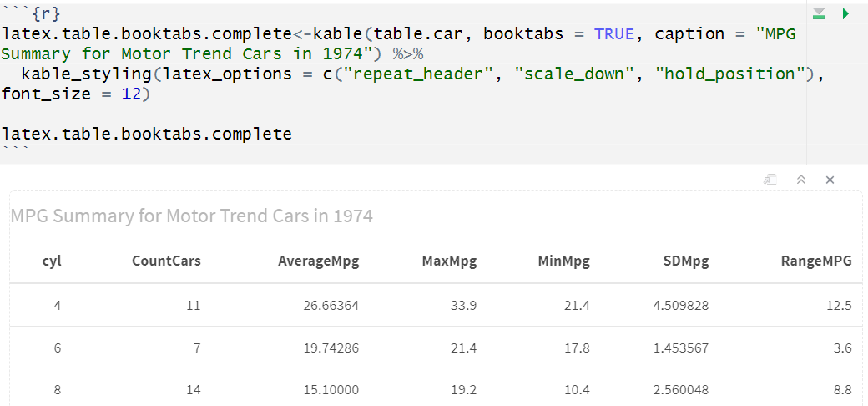
Many Different Options!
I have played around with this code a lot to get the desired style.
Here is an example of my code:
You can hold position, scale text, repeat header if it scrolls over pages, and choose font size.
These are all options and are not necessary

Slide 39
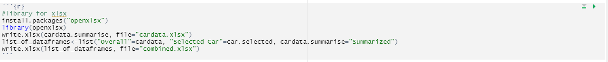
Exporting Data to CSV
Even if you create a nice report, it's always nice to keep a copy of your data in a csv or excel file.
R has a few packages that can help with that!
Writing to xlsx file
You can either write individual data frames or a list of data frames to multiple tabs in excel.

Slide 40
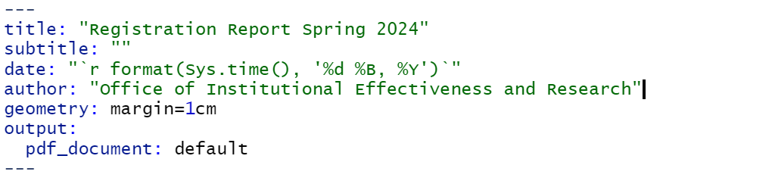
YAML Headers
YAML stands for YAML ain't Markdown Language
Yes, it is recursive. No I didn't name it.
It has basic information on how to render your document.
You can add metadata, pictures, and options for the entire document in it.

Slide 41
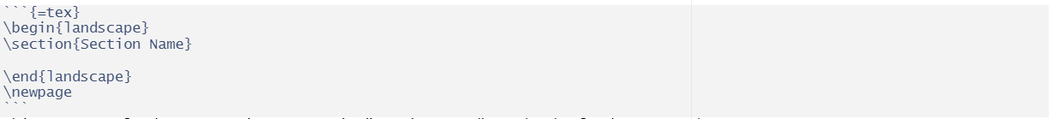
LaTex Commands and Knitting
There are some basic commands in LaTex that I use for reports.
The main one is newpage (\newpage)
create a line break in the document you are knitting.
\landscape is another code that you can use in order to change orientation of the document
You use the following code for the sections. Note the 4 \`’s
The last bit of LaTex I use is the section part
This starts a landscape section, names it "Section Name", ends the landscape, and creates a new page.
The code itself is in the middle.
The knit button on top compiles everything into a document!

Slide 42
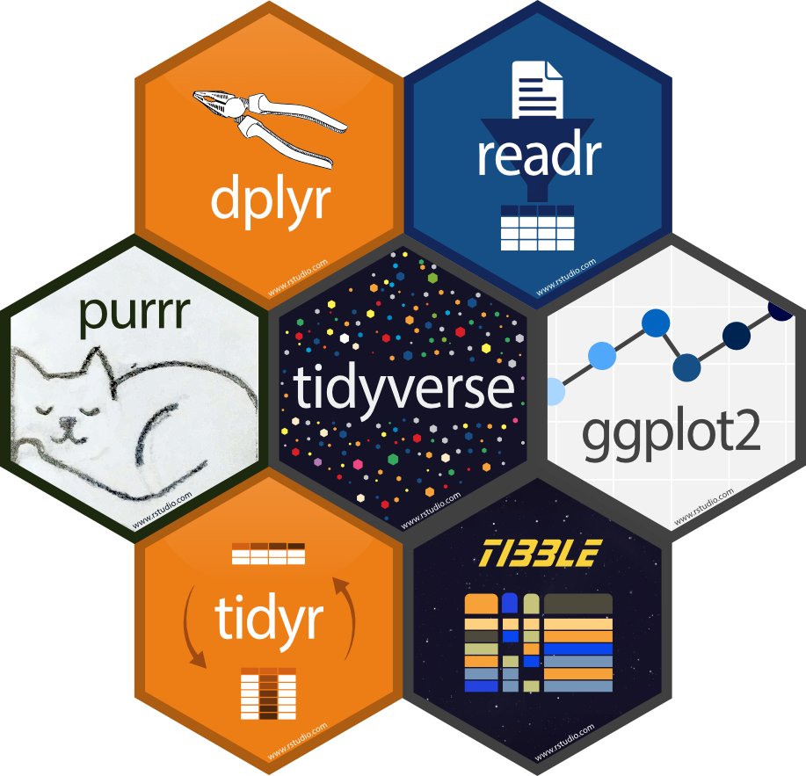
Questions and Quick Tips
Word of caution before dealing with YAML or LaTex sections. Save a copy before you start editing
Once you are done with everything you can go to the top and hit render.
Your document will run all the code and you will get a report.
It will have all the code that you have included in the report, and markup, and information or text you put in it.

